Slide 1
Sim 1 View Current Student List

Slide 2
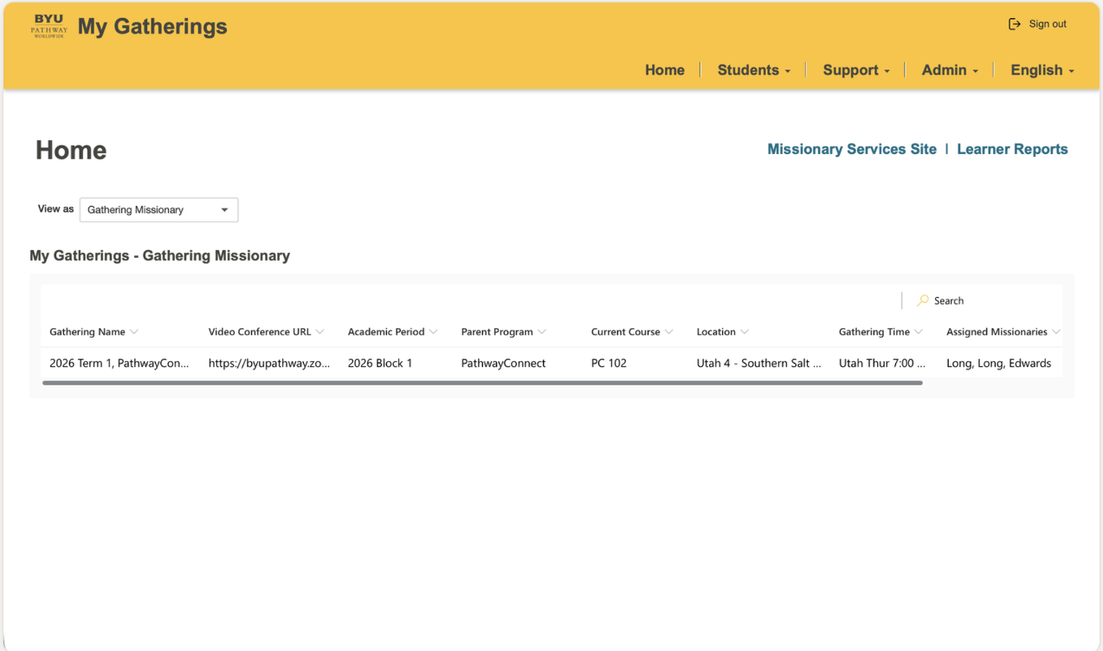
Sim 1 View Current Student List
Slide 1

Slide 3
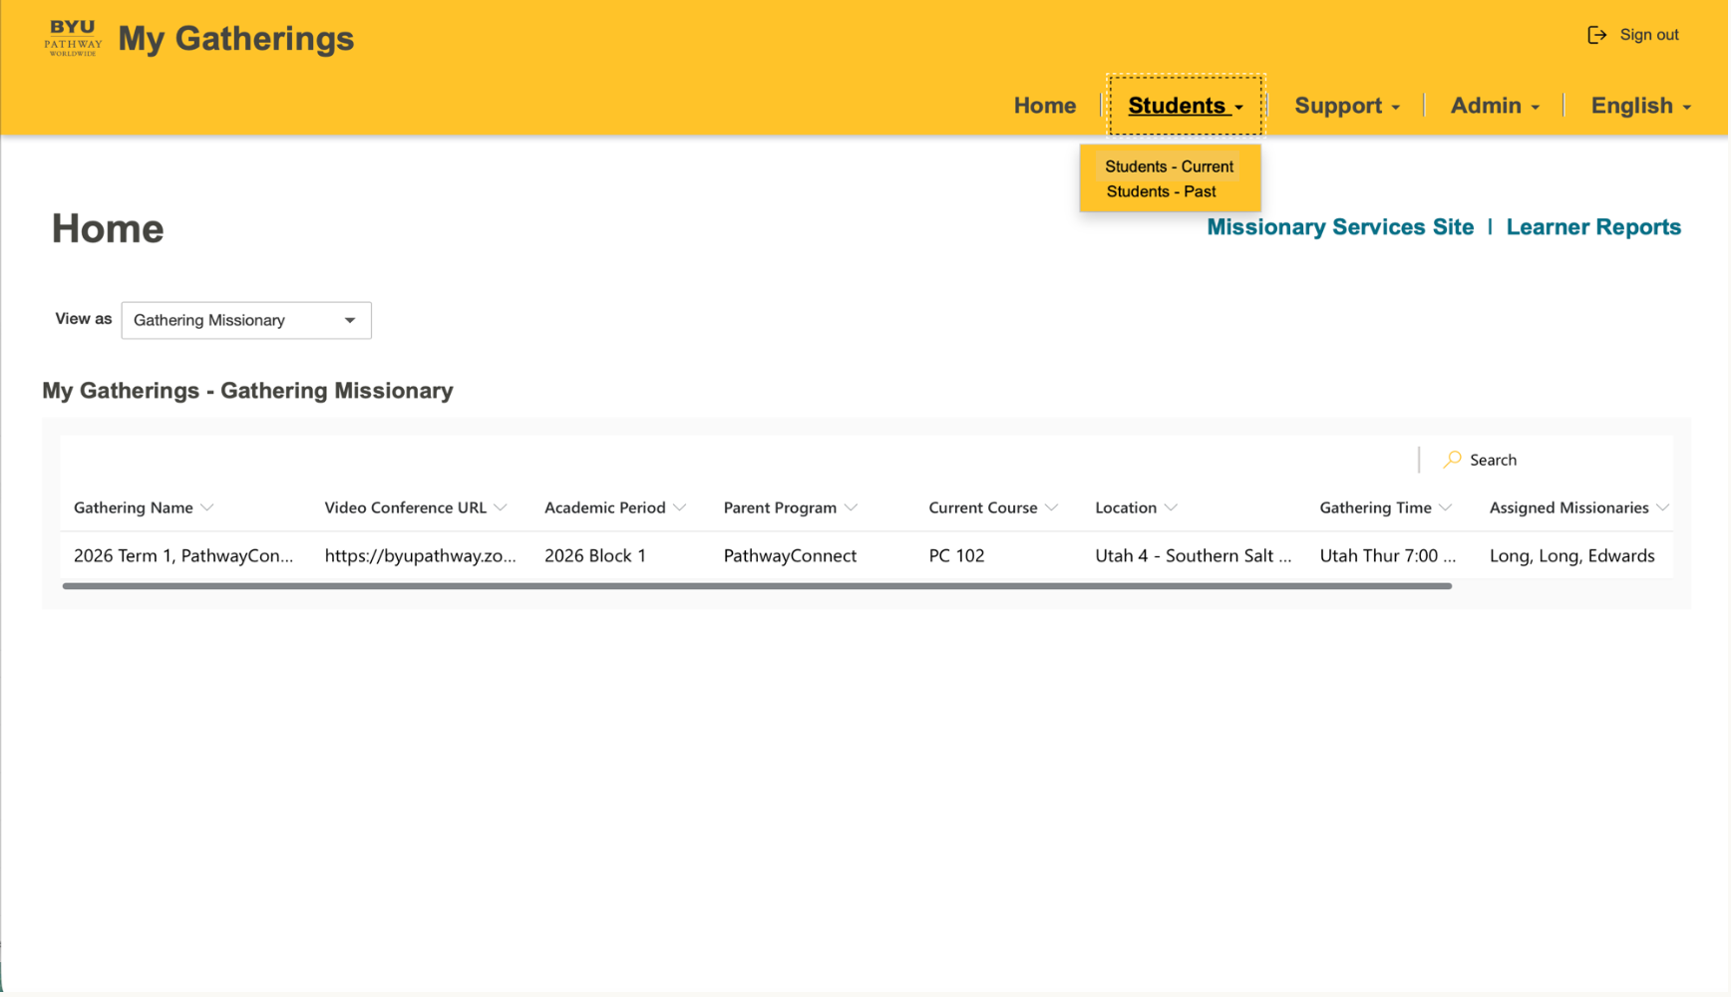
Sim 1 View Current Student List
Slide 2

Slide 4
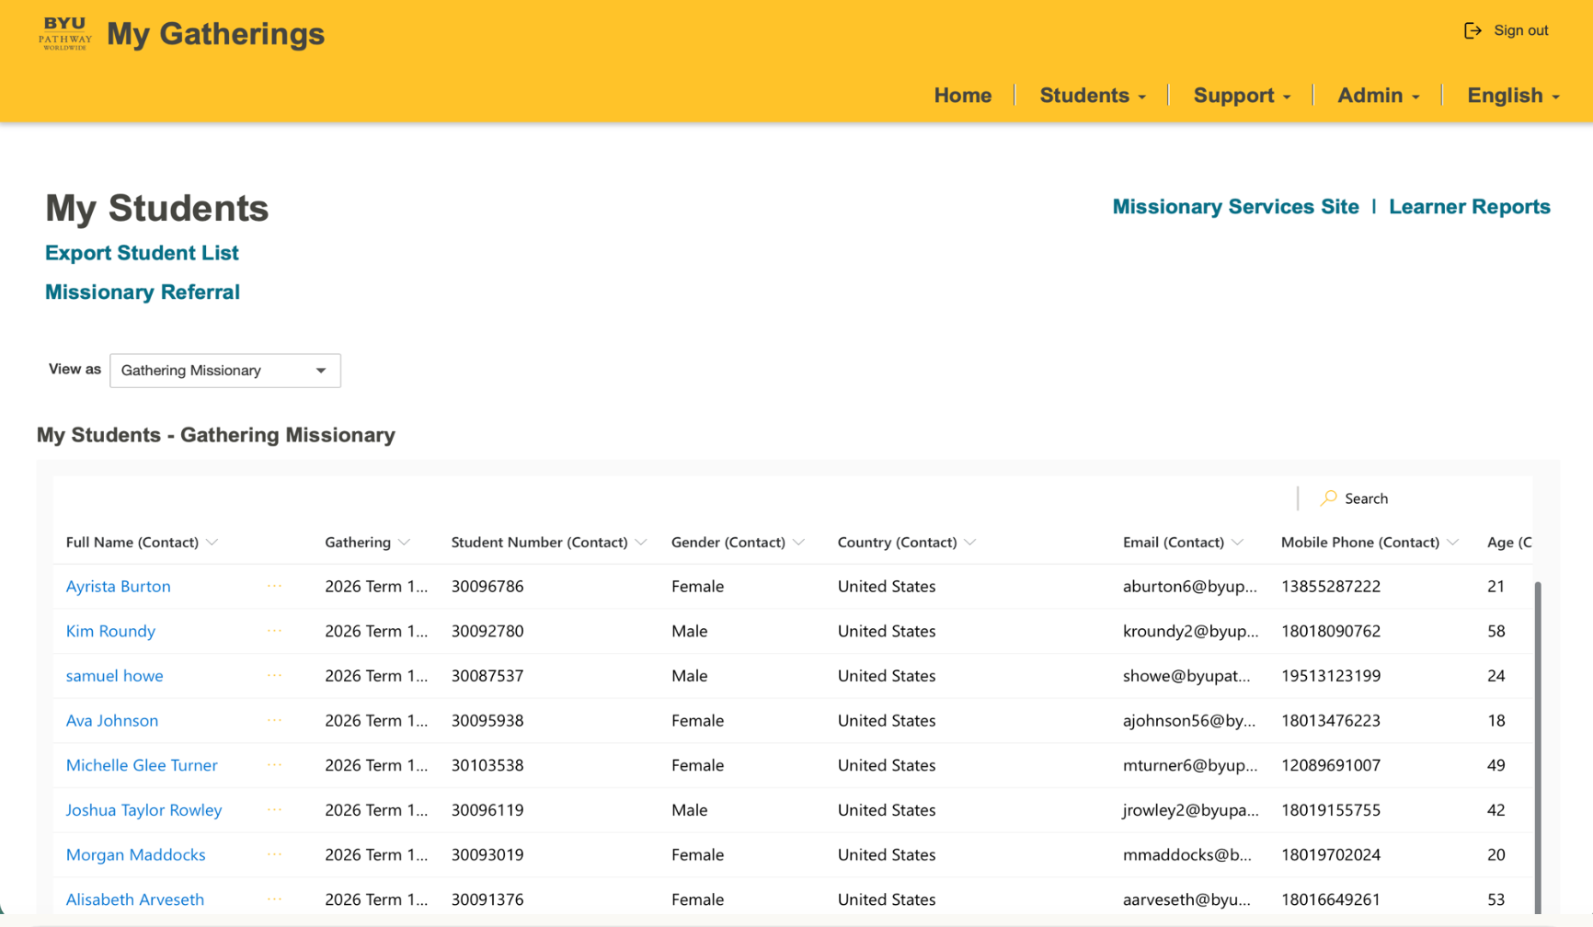

Sim 1 View Current Student List
Slide 3

Slide 5
Sim 2 Export Student List

Slide 6
Sim 2 Export Student List
Slide 1

Slide 7
Sim 2 Export Student List
Slide 2

Slide 8
Sim 2 Export Student List
Slide 3

Slide 9
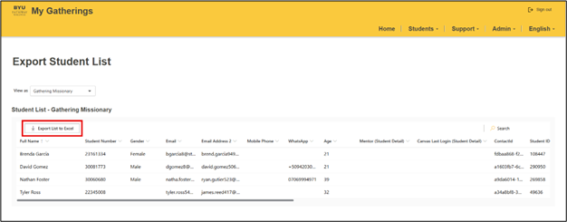

Sim 2 Export Student List
Slide 4

